Slide 1




Myanmar’s Rural Transformation:
Evidence from the Food Security Policy Project
Ben Belton
Michigan State University,
Food Security Policy Project
May 23, 2019
MSU, East Lansing

Slide 2
Rural Myanmar
Political & economic reforms from 2011
Least developed economy in SE Asia
Population 70% rural; Agricultural GDP = 26%
Conventional view of Myanmar’s rural economy is of stagnation:
“The level of agricultural mechanization in Myanmar is still low… not a surprise given the low wages in rural areas, the excess agricultural labor, and the still-lacking infrastructure and regulatory environment for machinery service providers… Farmers in general do not have the access to long-term capital, preventing investments in agricultural machinery” (World Bank, 2016)
FSPP research shows situation changing very quickly

Slide 3
Food Security Policy Project
USAID & LIFT funded partnership implemented by MSU, CESD, and IFPRI – October 2014-2019
Objectives:
  Generating new knowledge to inform better agricultural policy
  Capacity building and strengthening for research and policy
Components:
  Agricultural value chains and livelihoods research - 5 HH surveys (total ≈7300); 4 community surveys (total ≈ 700); 8 enterprise surveys (total ≈ 800)
  Policy advising - Agricultural Policy Unit in MOALI; advice to donors
  Training and outreach (national partner staff involved in entire research, analysis, outreach process - 7 now studying abroad, 4 applying; 45 publications; many presentations)
Notes:
MTW, AH, KH, PP, STK, ZWA, ASP (LSK, HH, kid), KZW, MZ, ETTT, ZMN; KMT, HE, KWS, AC

Slide 4
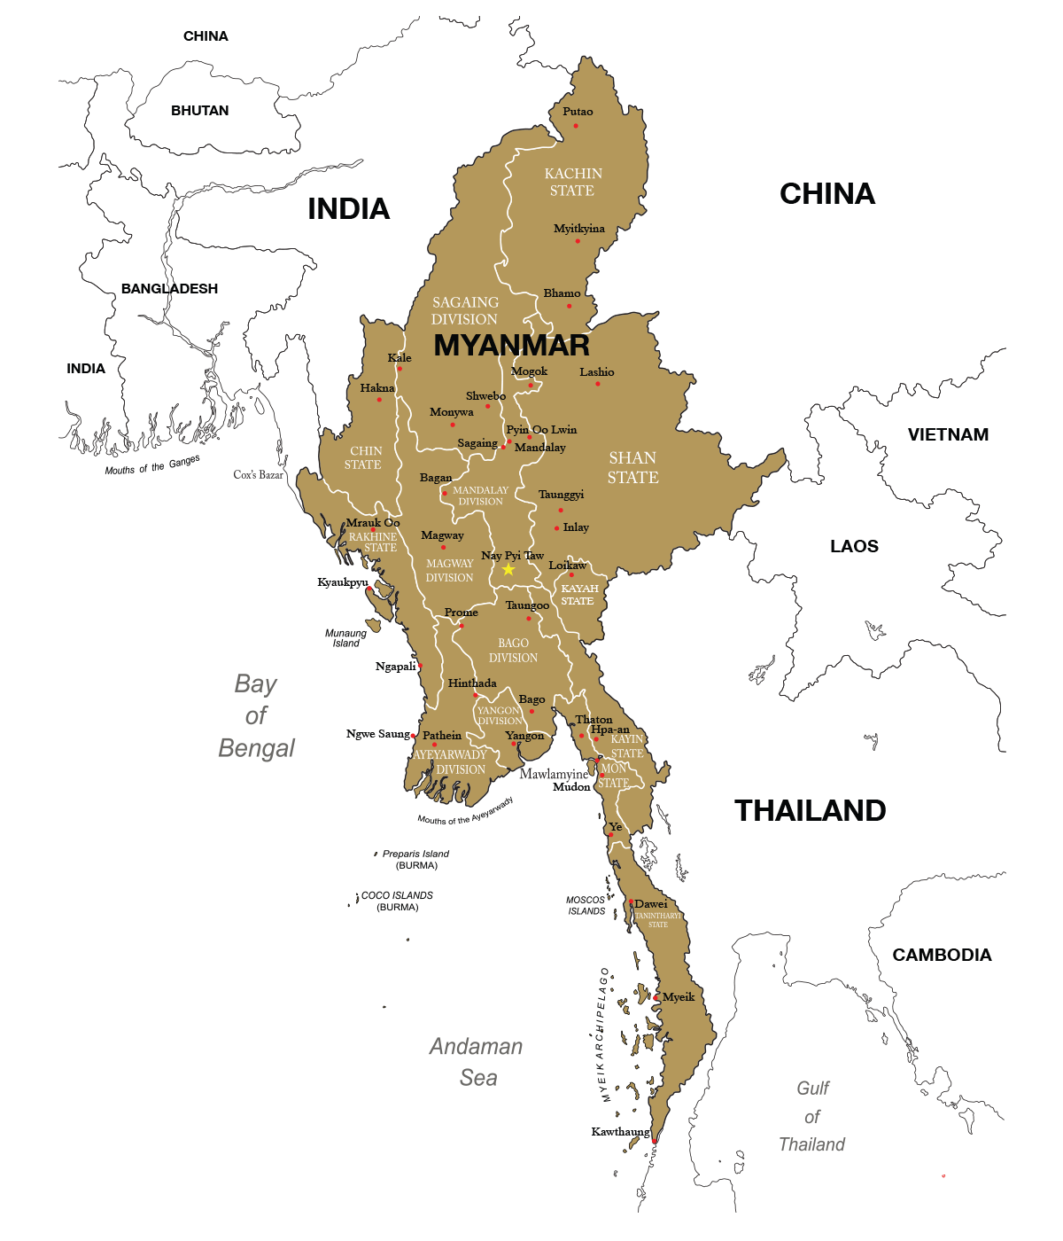
Shan
Dry Zone
Mon
Delta

Slide 5
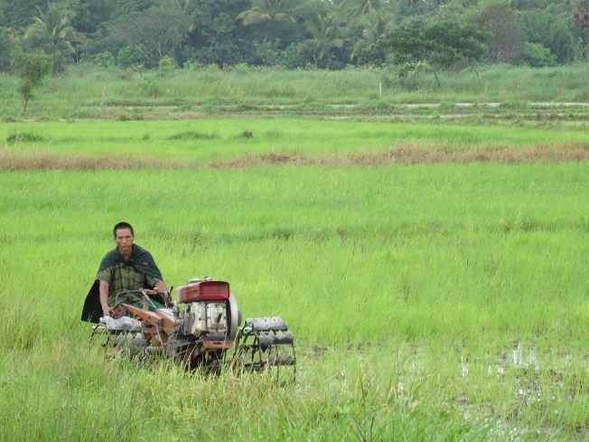
DELTA

Slide 6
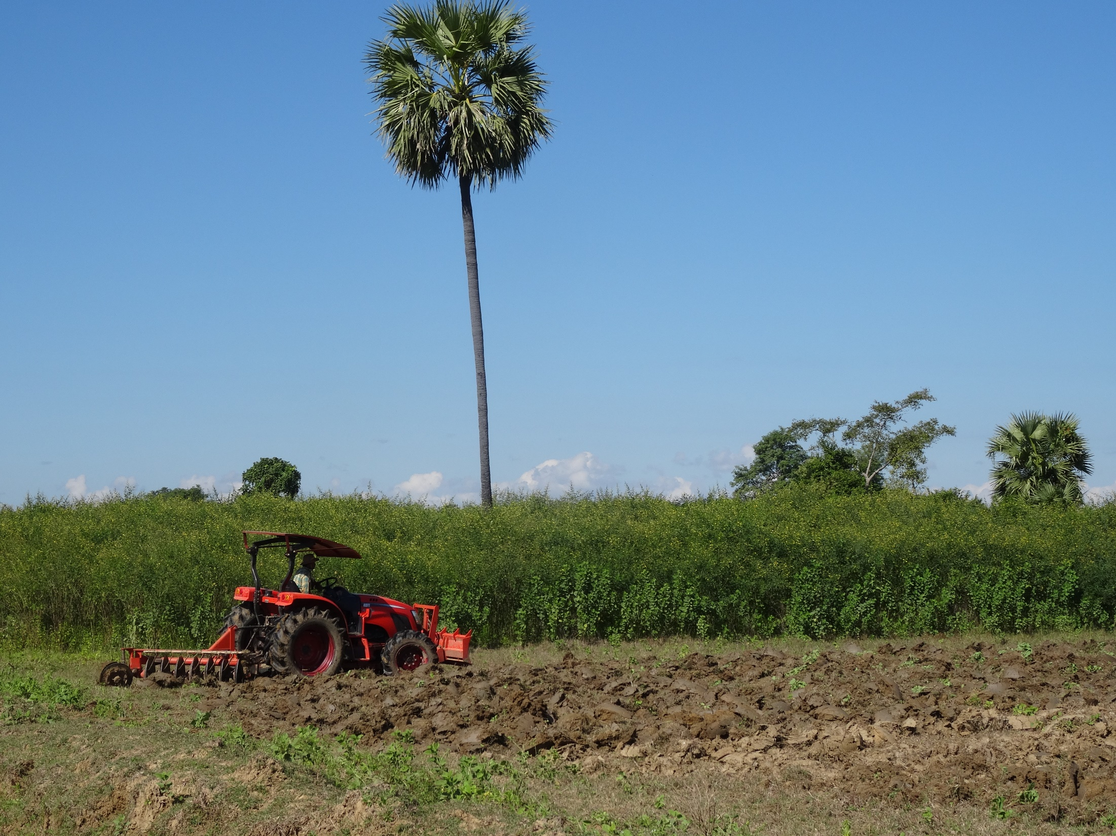
DRY ZONE

Slide 7
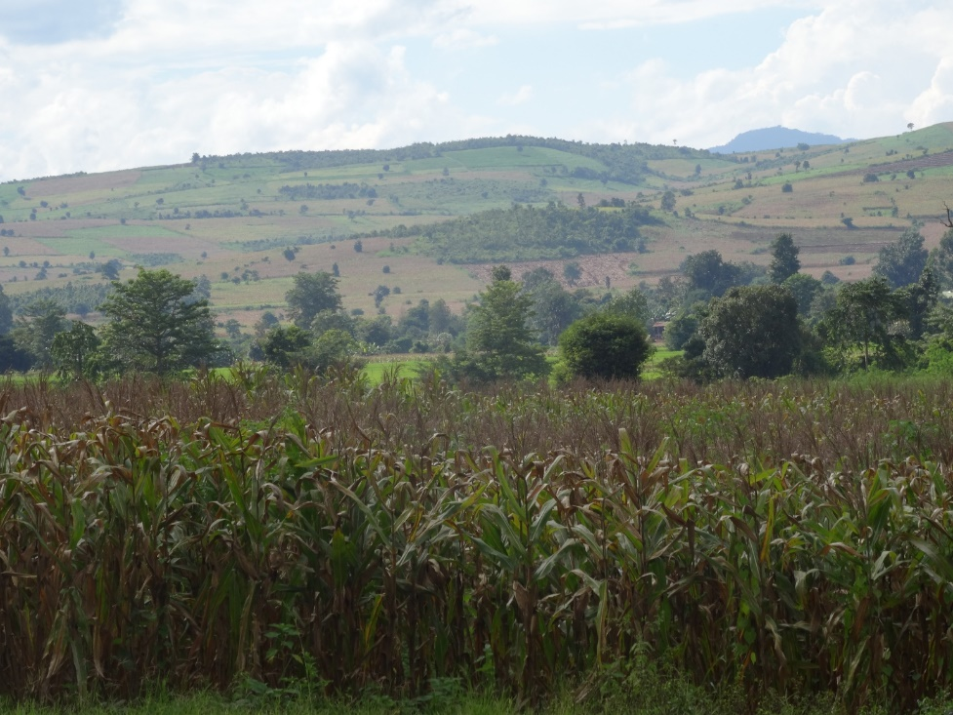
SHAN

Slide 8
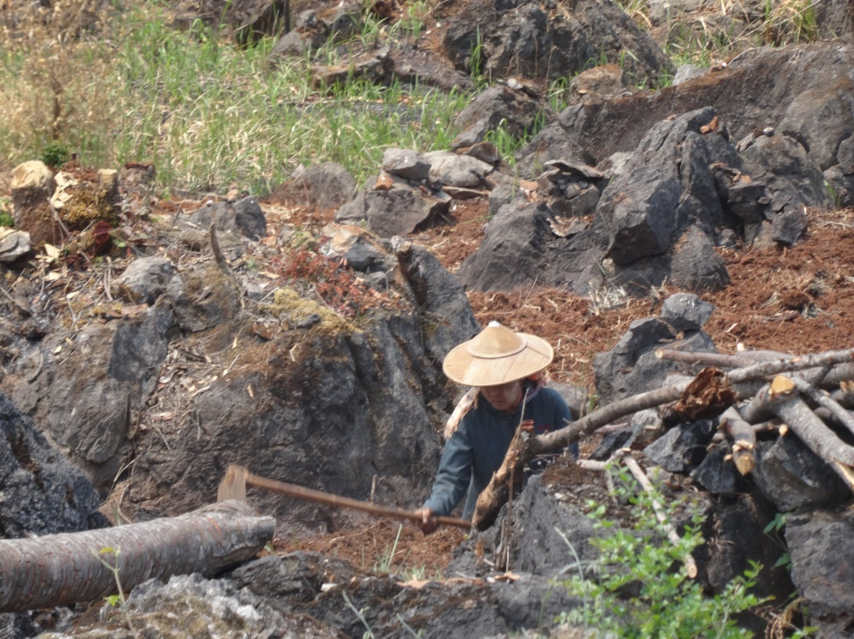
1. Agrarian structure & livelihoods

Slide 9
Regional variations in landholdings and tenure security
 | Delta | Dry Zone | Shan
High levels of landlessness: | 60% | 40% | 15%
Small-moderate landholdings: | 4 ha | 2.6 ha | 1.4 ha
Variable tenure security: | 25% no document | 12% no document | 75% no document
High levels of land confiscation: | 43% disposed parcels | 15% disposed parcels | 30% disposed parcels

Slide 10
Variations in landholding reflected in structure of rural economy
Income shares, by activity | SHAN | DRY ZONE
Own farm | 58 | 31
Agricultural labor | 7 | 19
Non-farm labor | 5 | 6
Salaried work | 8 | 6
Own enterprise | 13 | 21
Remittances | 8 | 15
NRE | 1 | 1
Share of HH income, by source – Shan and Dry Zone

Slide 11
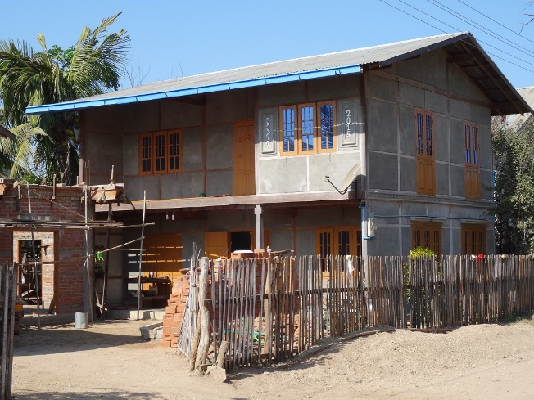
2. Migration

Slide 12
Migration common everywhere but with big regional variations
Share of HH with current migrant

Slide 13
Recent phenomenon, accelerating
Rapid growth since 2010
Destinations differ by region (more international near borders)
Growing pull from cities in Myanmar

Slide 14
Little variation in likelihood of migration by gender or landholdings
Migrant occupations and earnings delinked from landholdings
– opportunities for social mobility
Landless
Tercile 1
Tercile 2
Tercile 3
Share of migrants by gender
Share of HH with migrants by landholding group (all 4 surveys)
Notes:
Note: First bar will go down once we add Shan State.

Slide 15
Migration linked to rising rural wages
Delta
Dry Zone
Change in real daily wages for male casual labor (Delta & Dry Zone)

Slide 16
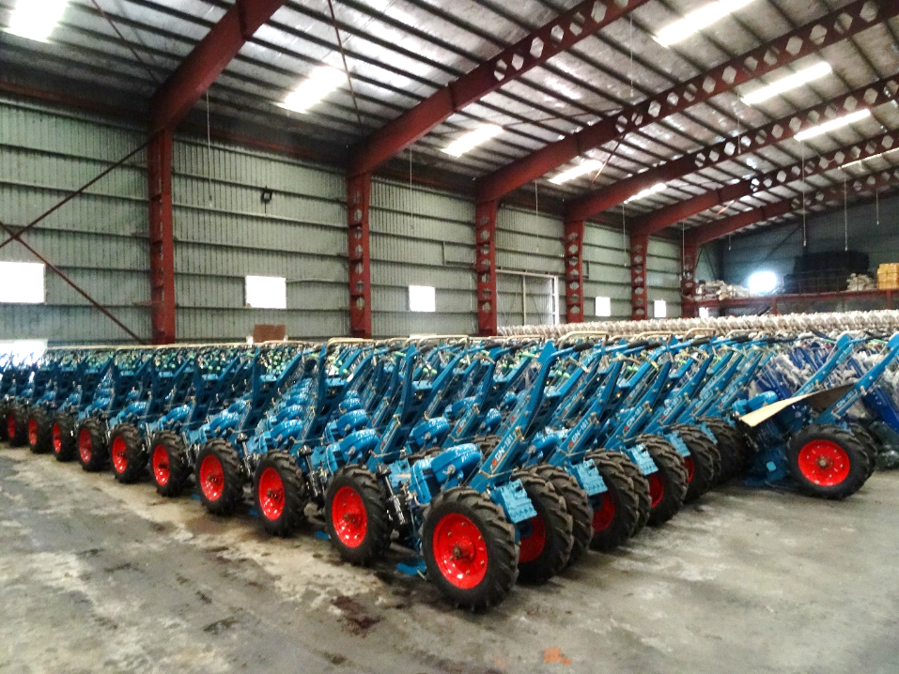
3. Agricultural mechanization

Slide 17
Cumulative Purchases of Selected Machinery (1990-2015), Delta
Huge increase in machine ownership in past decade

Slide 18
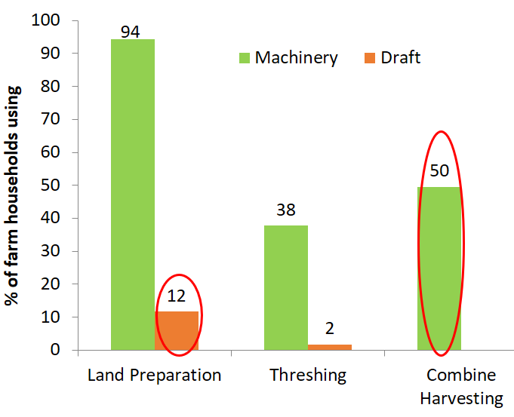
Machines displacing draft animals; mechanized harvesting
% OF FARM HOUSHEOLDS USING
Driven by need for labor savings, availability, convenience, timeliness
Share of farmers using machinery & draft animals, for land preparation and harvesting, 2016 (Delta)

Slide 19
Rental services enable access to machines
Share of farming HH using own or rented machines in land preparation and threshing (Shan)

Slide 20
Scale-neutral at point of use for all types of machine
Share of HH using machinery by landholding tercile and machine type (Dry Zone)

Slide 21
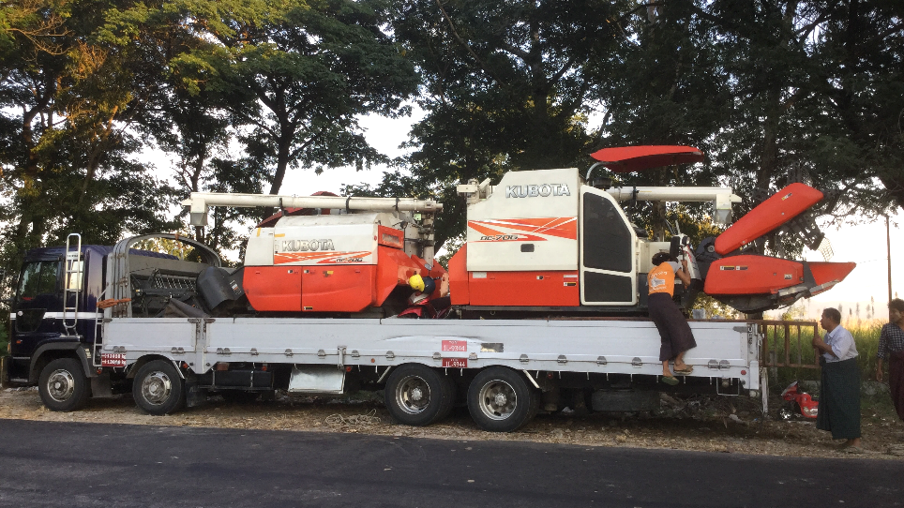

Slide 22
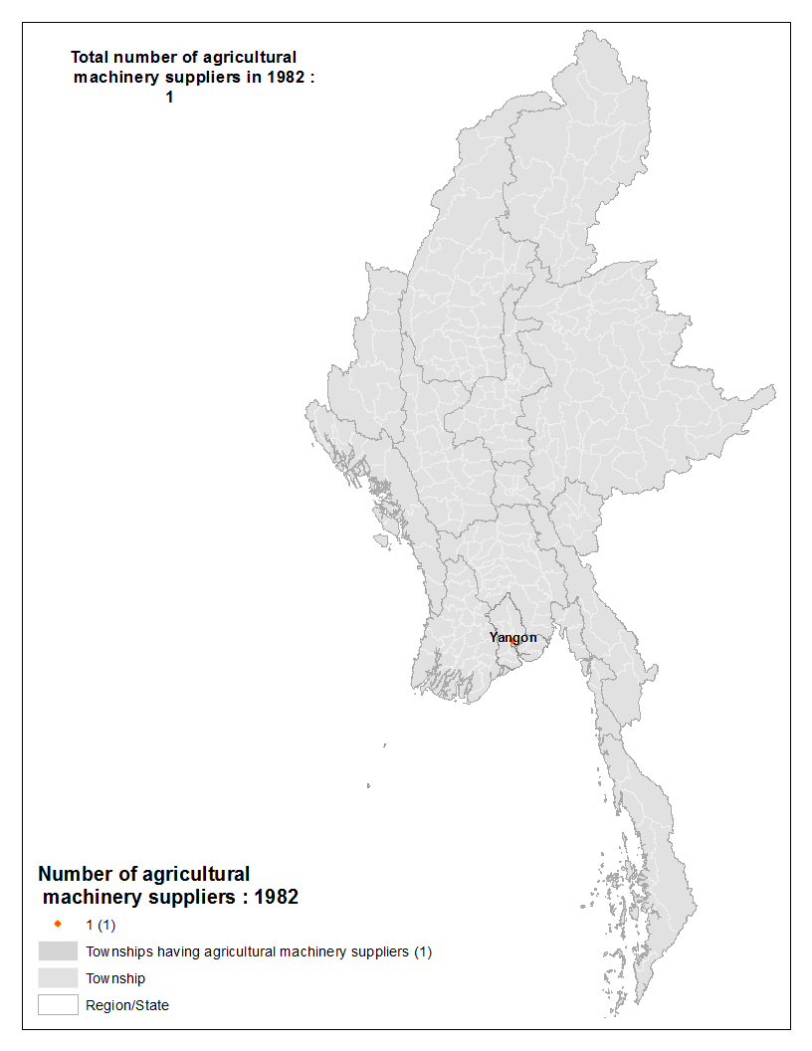
Spatial growth in machinery supply businesses during the past 25 years
Number of agricultural machinery supply businesses by township, 1982-2018 (Delta & Dry Zone Enterprise surveys)

Slide 23
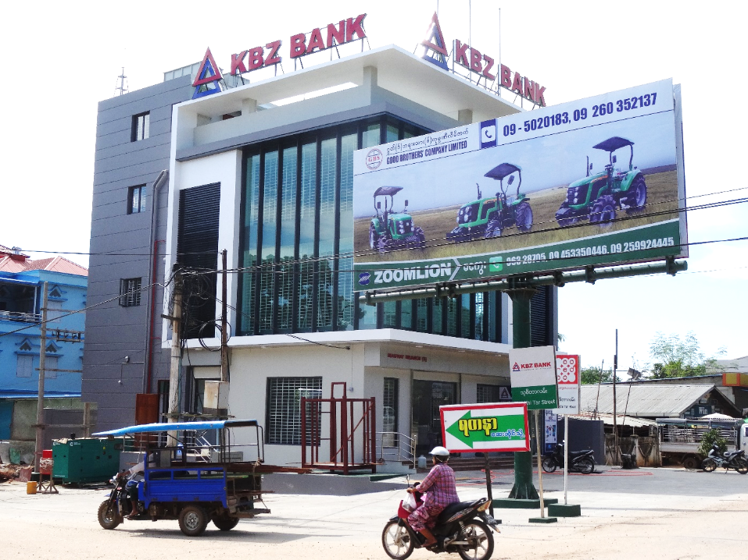

Slide 24
Remittance incomes & rising wages more than compensated for reduced demand for farm labor (Dry Zone)
Demand for agricultural labor fell by 8%
Real wages increased 40% from 2012-2016
Change in household income by landownership type ($/HH)
Source: Belton & Filipski, 2019

Slide 25
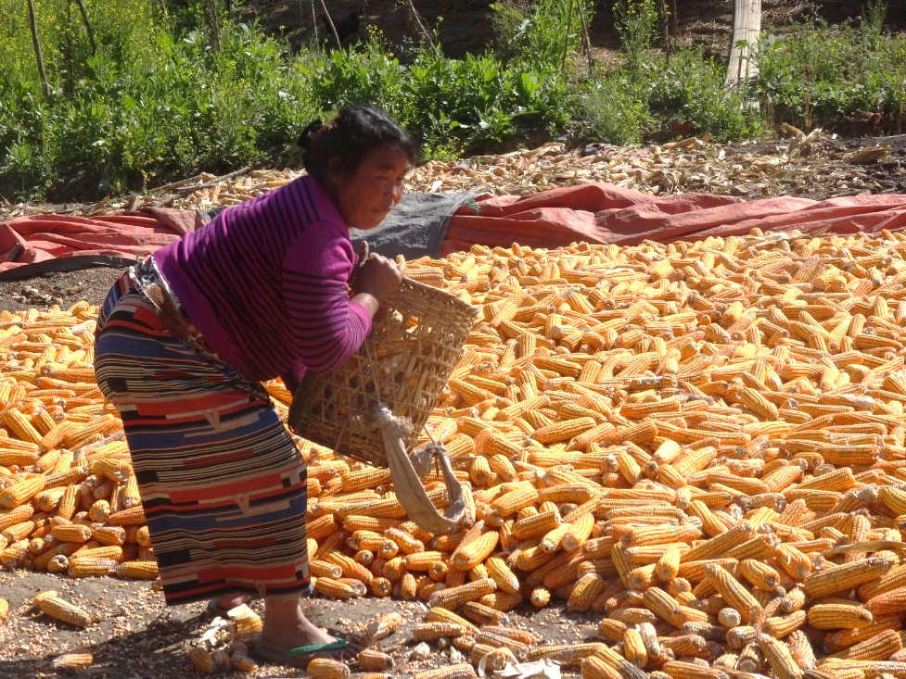
4. Agricultural technology change & VC transformation

Slide 26
Limited intensification of paddy in Delta

Slide 27
Stagnating crop yields in rainfed Dry Zone
Little use of improved varieties,
Slight increase in use of purchased inputs
Little yield response except in paddy

Slide 28
Variable, low gross margins (Dry Zone)

Slide 29
BUT, agriculture in responsive to new opportunities & technologies under right circumstances
Shan hybrid maize boom - 46% of HH growing maize
Jump in use of hybrid seed, fertilizer
Number of HH starting activity, by year first started

Slide 30
The market for maize seed is diverse and competitive
40%

Slide 31
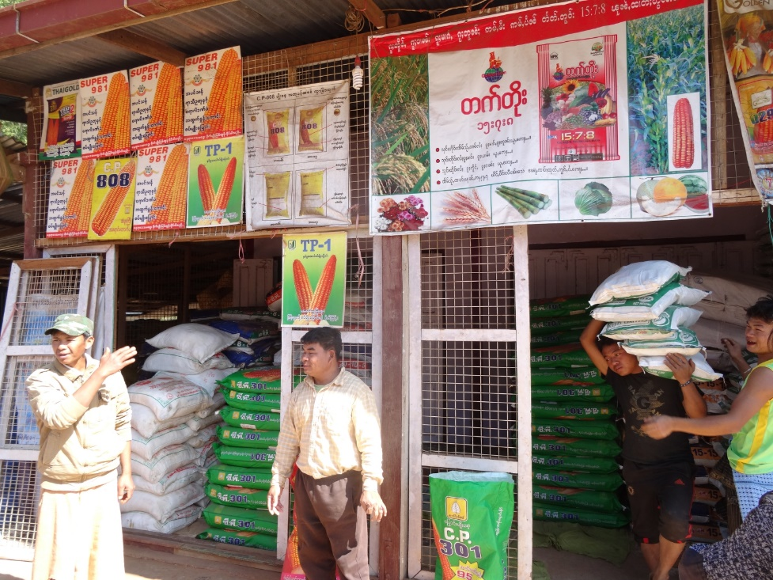

Slide 32
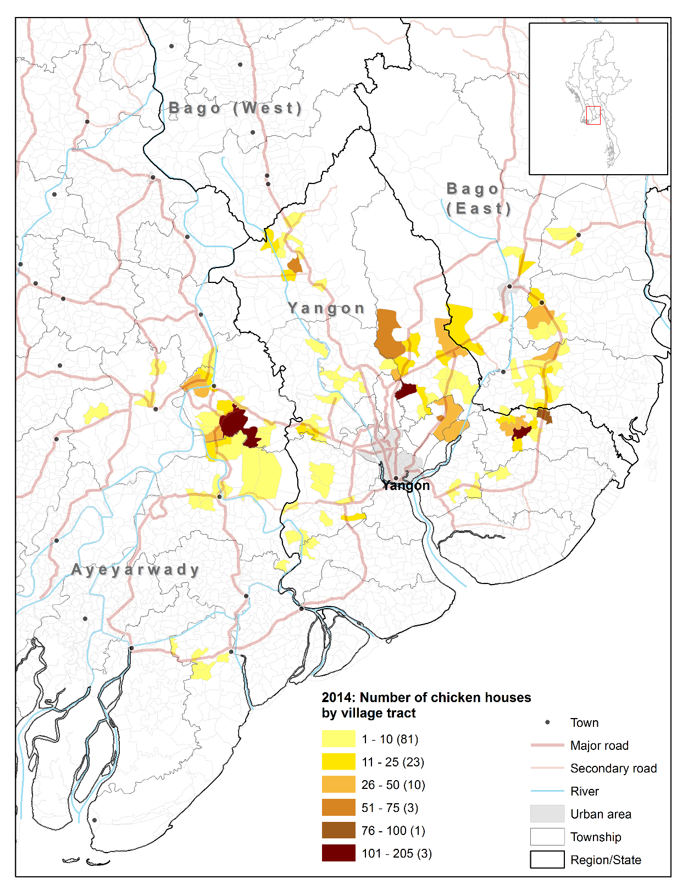
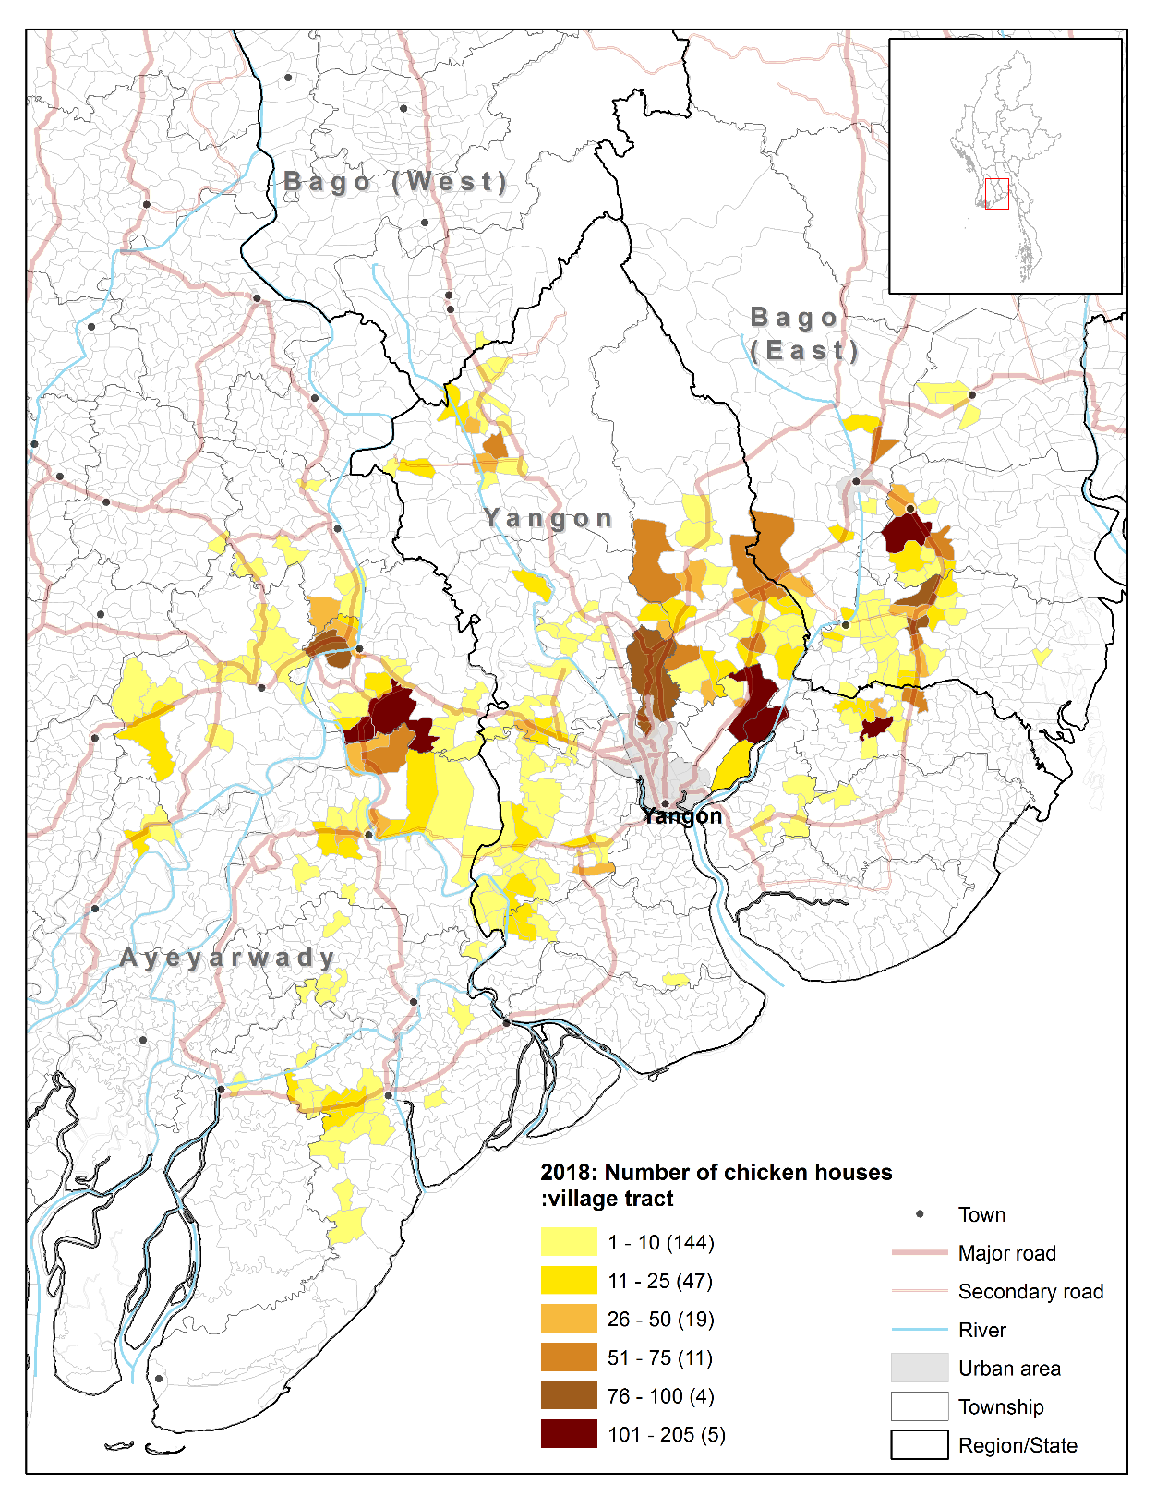
Maize boom linked to poultry boom
2014
2018
2014 = 1898 houses in 121 village tracts
2018 = 3868 houses in 230 village tracts

Slide 33
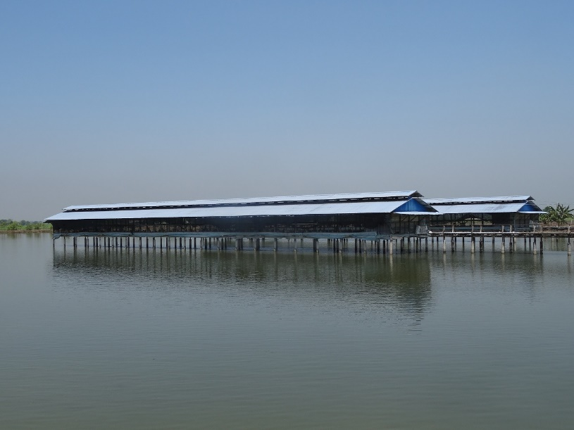

Slide 34
Growth of off-farm value chain segments
Enterprise | 2006 | 2016 | % change
Hatchery | 30 | 60 | 100
Nursery | 501 | 1538 | 207
Seed trader | 166 | 265 | 60
Pelleted feed trader | 5 | 11 | 112
Rice bran/oil cake trader | 112 | 175 | 56
Small boats for hire | 115 | 216 | 88
Fish trader | 46 | 68 | 47
Ice factory | 9 | 16 | 82
Mechanical excavator hire | 2 | 24 | 961
Trucks for hire | 1 | 20 | 1900
Growth of aquaculture mirrors growth of poultry
Farm growth facilitated by growth and innovation in ‘upstream’ and ‘downstream’ VC segments
Nurseries + 200%
Seed traders + 60%
Inventory of enterprises in the aquaculture value chain, in villages with high concentrations of fish farms, Myanmar, 2006-2016
Notes:
Fish farm growth supported by “quiet revolution”, in off-farm value chain, driven by mainly by SMEs

Slide 35
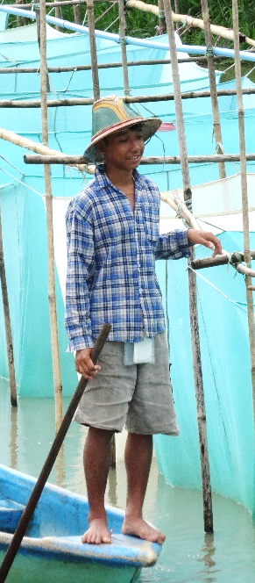
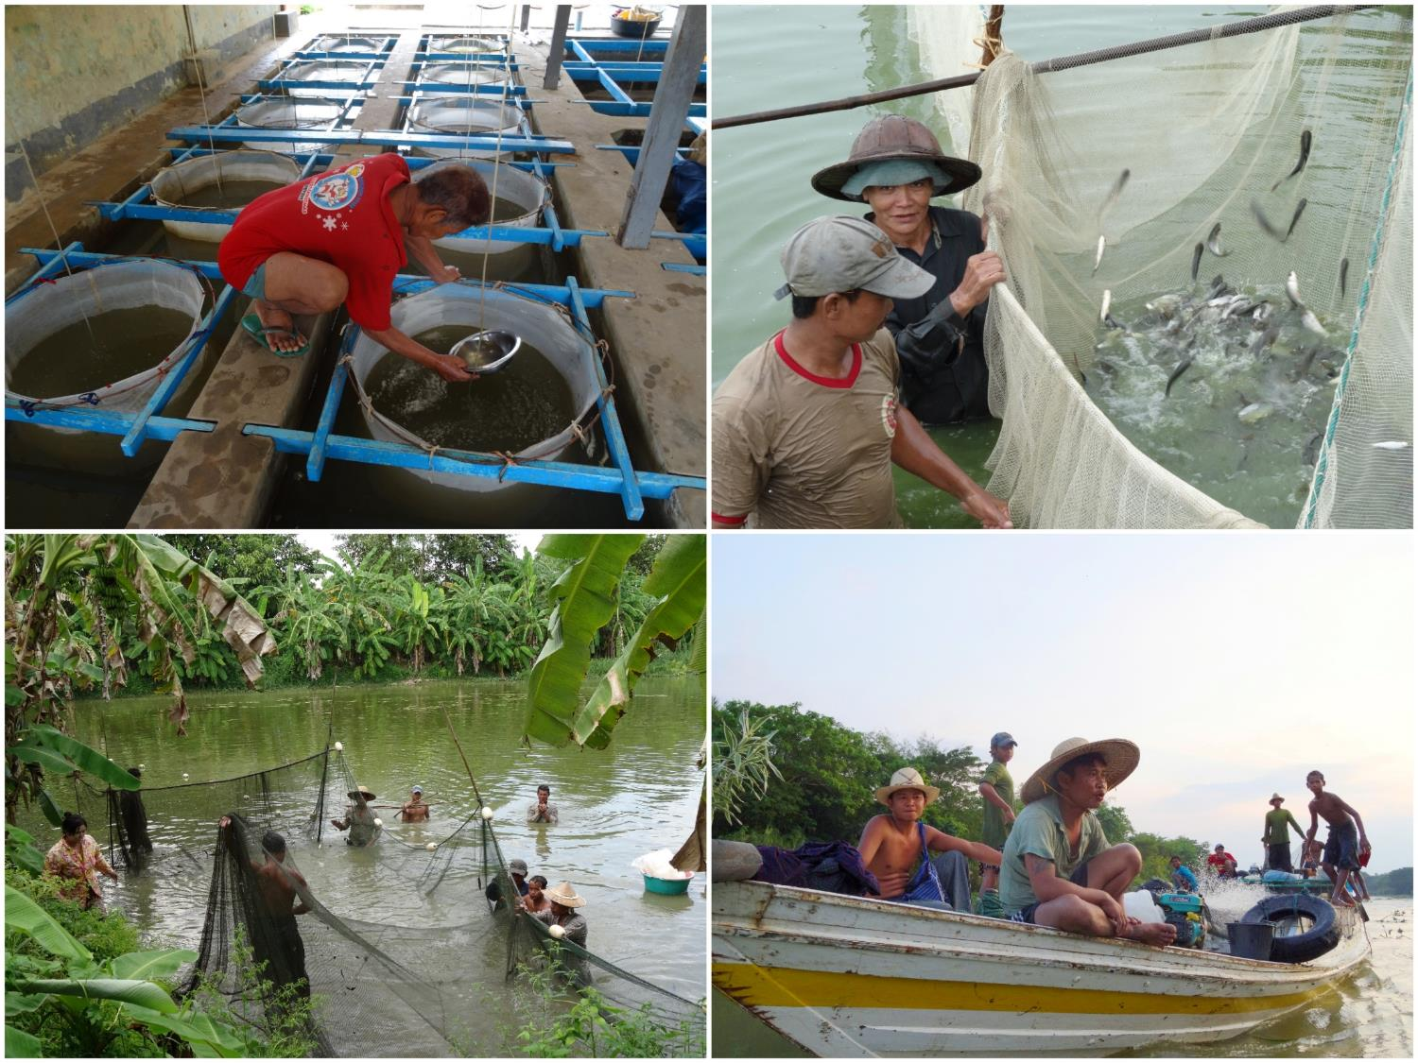

Slide 36
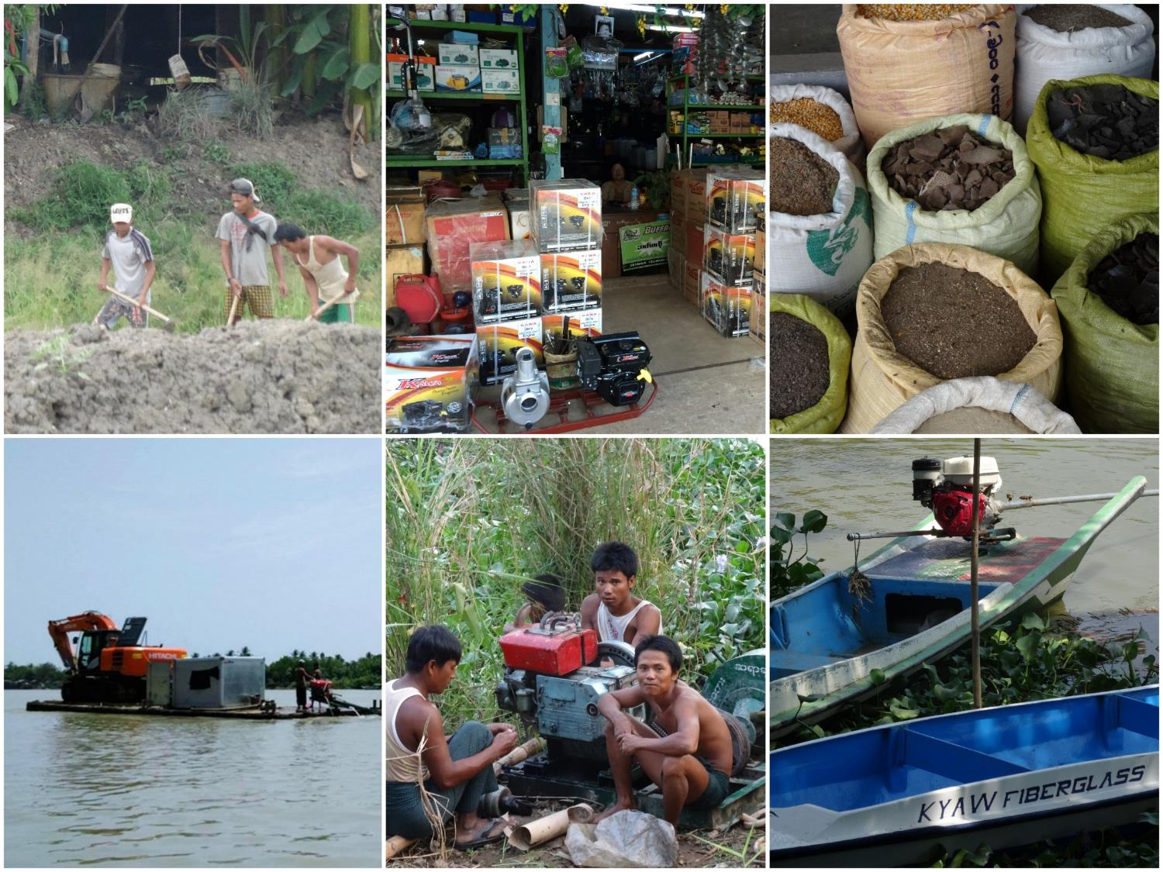
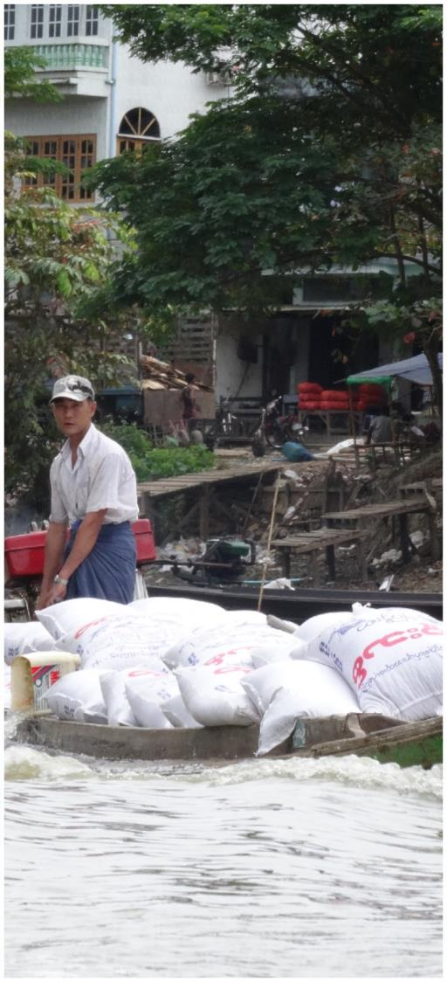

Slide 37
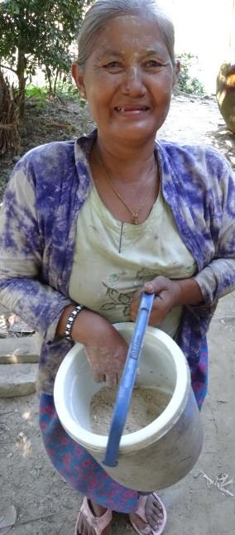
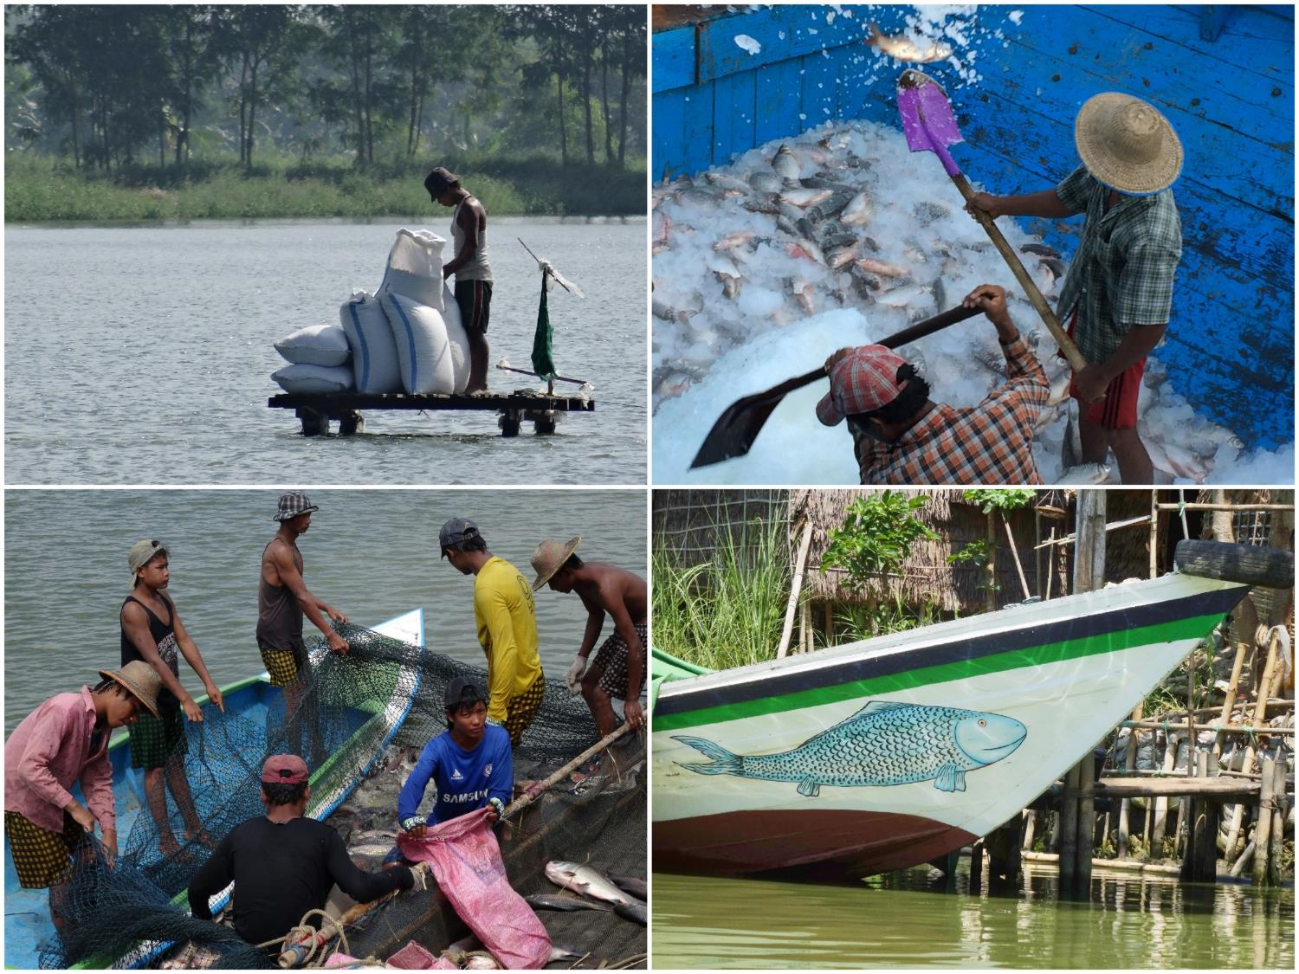

Slide 38
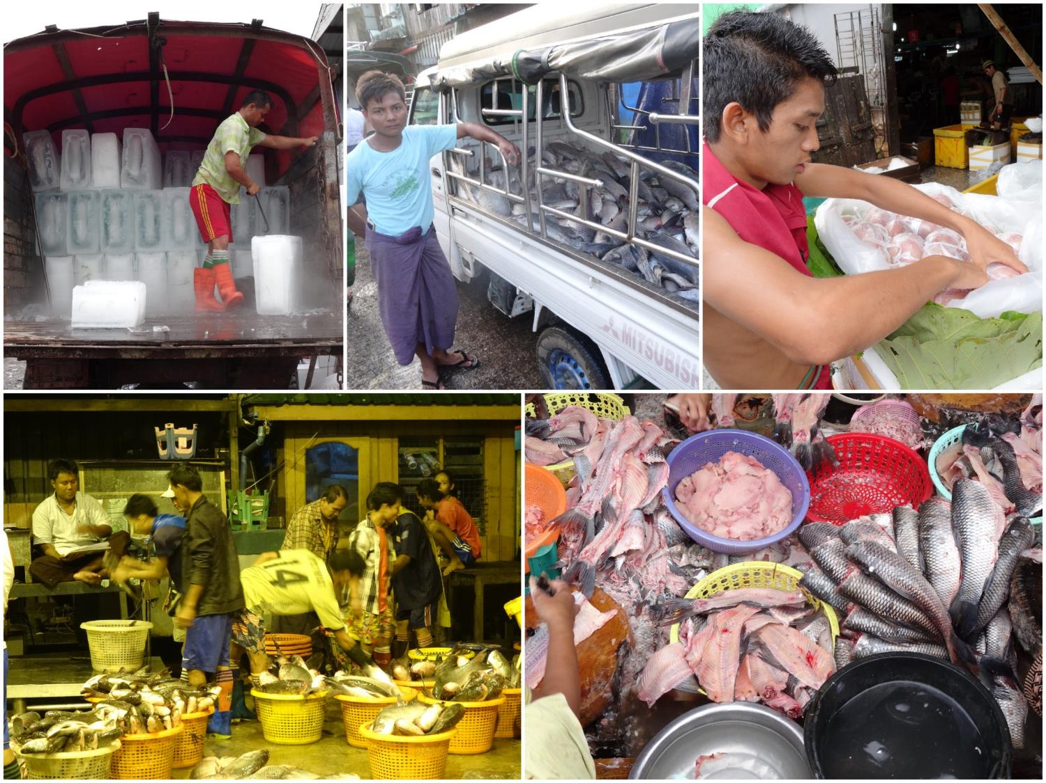
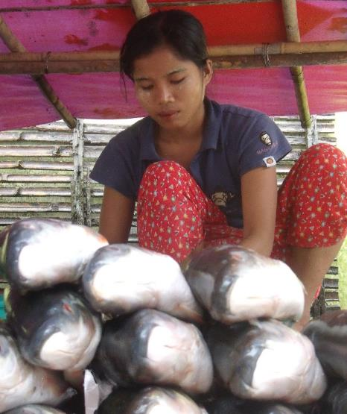
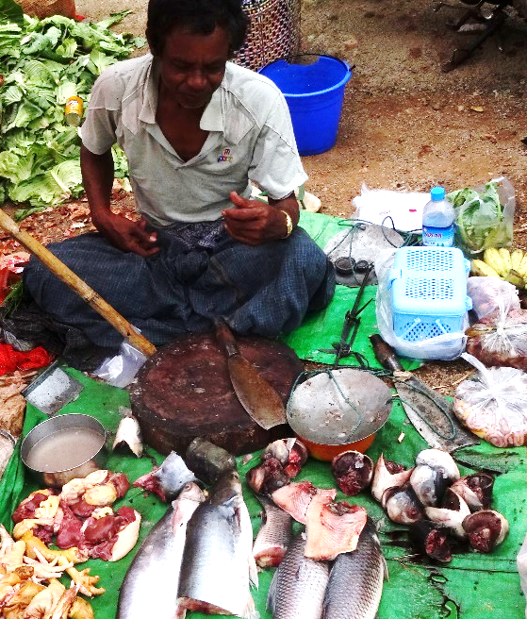

Slide 39
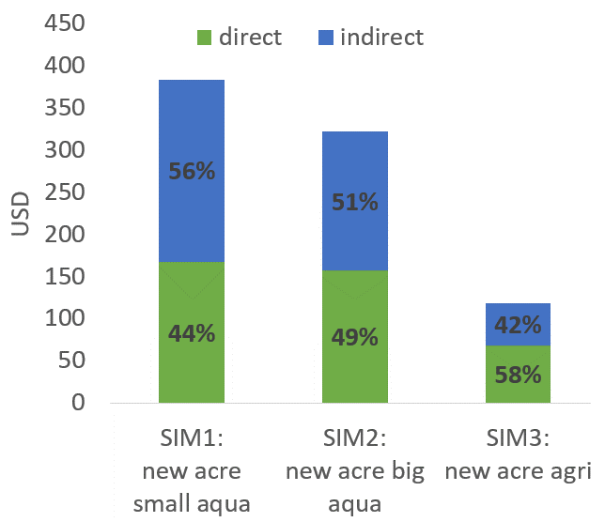
Income spillovers from employment and consumption linkages
Fish farms produce bigger economic spillovers than crop farms
Small commercial fish farms produce bigger indirect spillovers than large fish farms
Estimated local economy-wide direct and indirect income gains from additional acre of land utilized by large fish farm, small fish farm and crop farm, Myanmar (Filipski & Belton, 2018)

Slide 40
Conclusions
FSPP has documented rapid rural transformation in Myanmar
Common trends but shaped by variations in regional geography
Remittance incomes and rural wage increases more than compensate for reduced income earning opportunities associated with mechanization
Rising rural wages have improved the position of households dependent on off-farm labor, relative to those dependent on farming
Non-farm employment and migration will play an increasingly important role in underwriting the future of agriculture
Large income spillovers associated some higher value forms of farming (e.g. aquaculture)

Slide 41
Implications for policy & programming
Information gathered by project widely used by donors to direct investment decisions, uptake by government slower
Capacity building for individuals highly successful, institutions more challenging
Diverse geographies require diverse development strategies
Migration is a key driver of rural transformation – need to reduce risks and maximize benefits
Support for engagement in and diversification of RNFE

Slide 42
Implications for policy & programming
Reform land use policy to support agricultural diversification (e.g. fish) and provide protection from land confiscation
Investments that leverage additional value from existing crops & supply chains (e.g. better varieties, improvements in cold chain, packing and handling, branding)
Explore introduction of technologies that support higher value production (e.g. greenhouses, small-scale irrigation)
New modes of agricultural development (e.g. agro-tourism).
Improve trade regimes and diversify markets for greater price stability for agricultural commodities

Slide 43
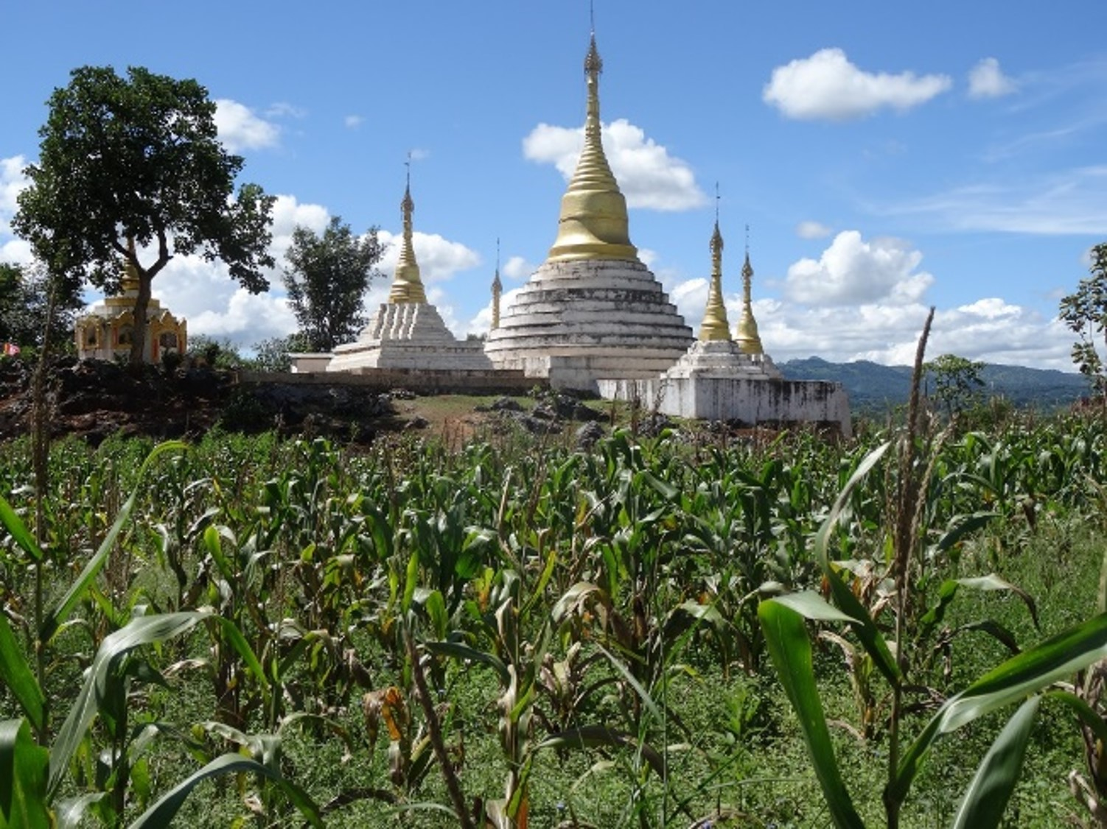
All FSPP publications available from: https://www.canr.msu.edu/fsp/countries/myanmar/publications

